Slide 1
VEM Tooling (Shenzhen) Co., Ltd.
VEM Thailand (Rayong) Co., Ltd.
VEM Tooling (I) Pvt Ltd. (India)
TOOLS MADE IN ASIA

Slide 2
Company Profile
1998: Company registered in Hong Kong as VEM Virtual Electronics Manufacturing Ltd
2000: Start to outsource plastic injection moulds in Shenzhen
2001: Set up sales office in US
2003: Set up 100% owned factory in Shenzhen, China, for plastic injection moulds with 1.000 m² factory size
2005: Moved the factory to a much larger and more advanced factory with 5.000 m²
2007: Set up sales office in Thailand
2008: Set up 2nd factory in Thailand with 3.000 m²
2010: Thailand got TS 16949 for parts production
2011: Set up sales office in Mexico
2015: Set up sales office in India
2016: Set up 3rd factory in India with 1.500 m²
22016:Set up 3rd factory in India with 1,500 sqm
016:Set up 3rd factory in India with 1,500 sqm

Slide 3
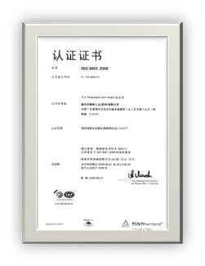
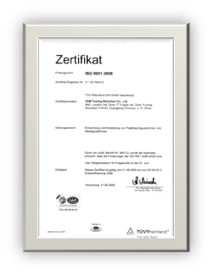
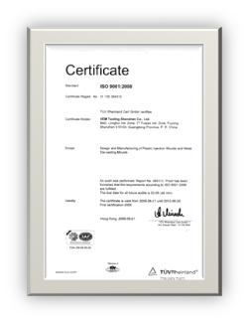
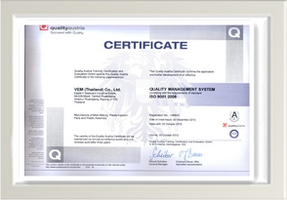
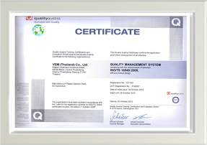
Facts about VEM
ISO9001 / TS16949 Certified
Range from 50 up to 500 t in China & 400 up to 1.000 t in Thailand & 50 t up to 600 t in India.
500 tools per year

Slide 4
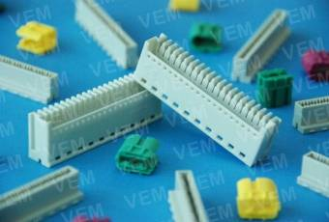
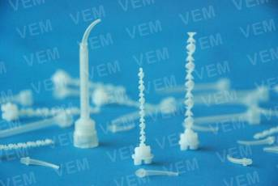
Specialties with VEM
Technical support in USA and Germany for mold design in special projects
Specialize in High Precision Molds, Multiple Cavity Tools with Hotrunners, Insert Molds, 2K Molds, Casting Die Molds
High Tolerance Swiss and Japanese Machining Centers

Slide 5
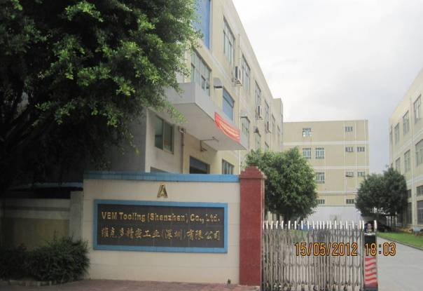
VEM China

Slide 6
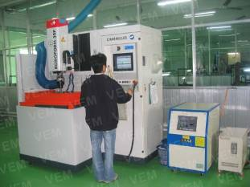
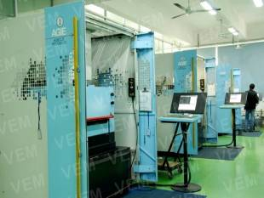
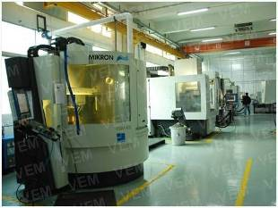
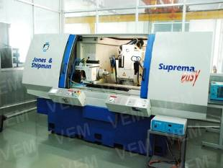
Production Site VEM China

Slide 7
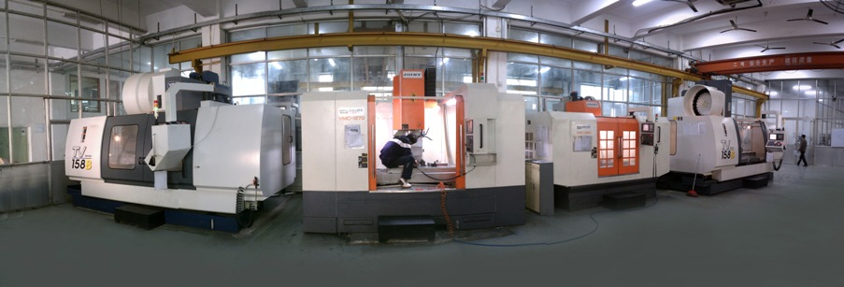
Mouldbases made in VEM China

Slide 8
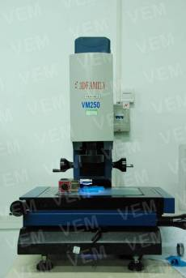
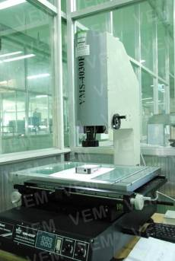
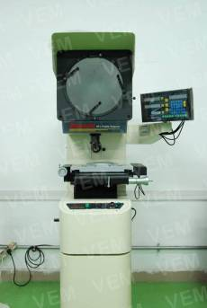
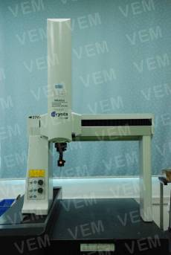
Measuring Equipment VEM China

Slide 9
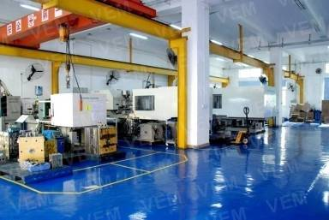
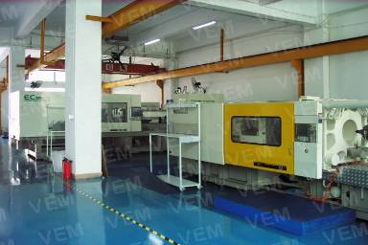
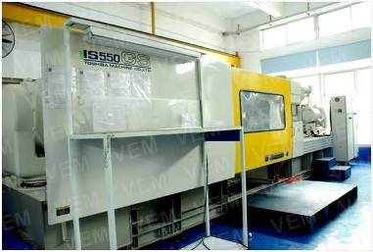
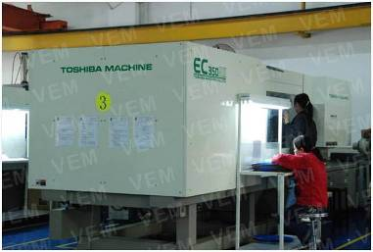
Injection Shop VEM China

Slide 10
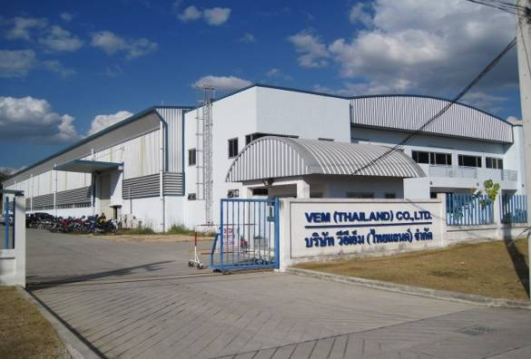
VEM Thailand

Slide 11
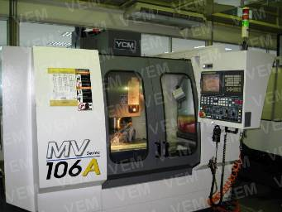
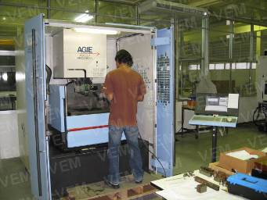
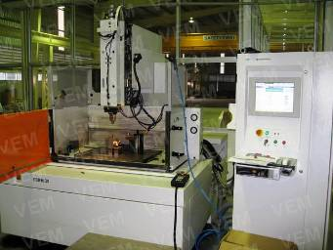
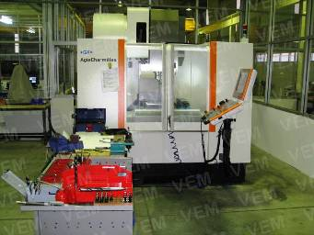
Production Site VEM Thailand

Slide 12
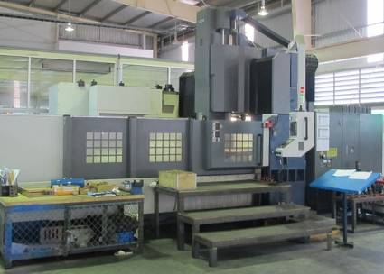
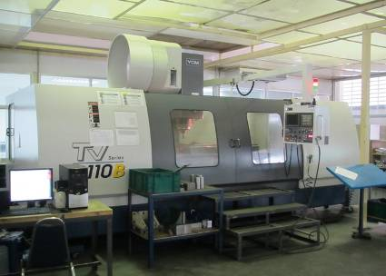
Mouldbases made in VEM Thailand

Slide 13
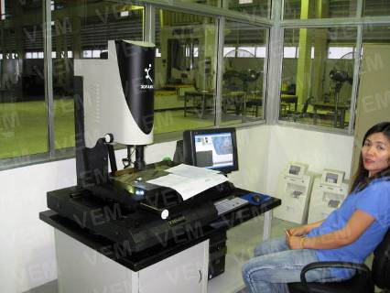
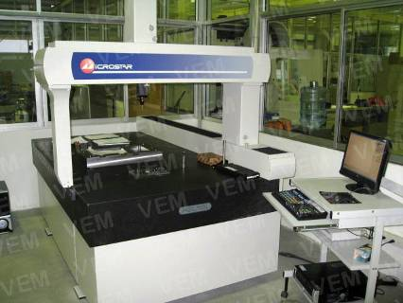
Measuring Equipment VEM Thailand

Slide 14
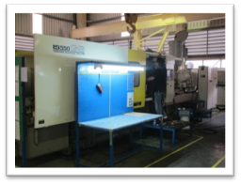
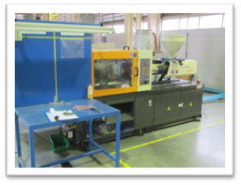
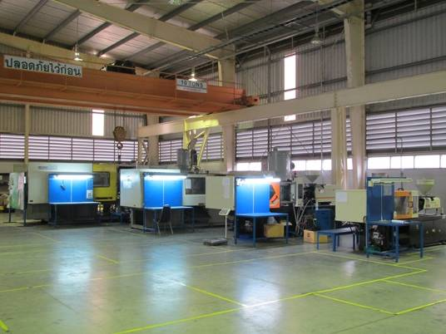
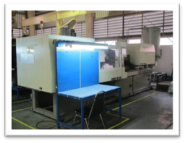
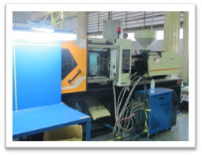
Injection Shop VEM Thailand

Slide 15
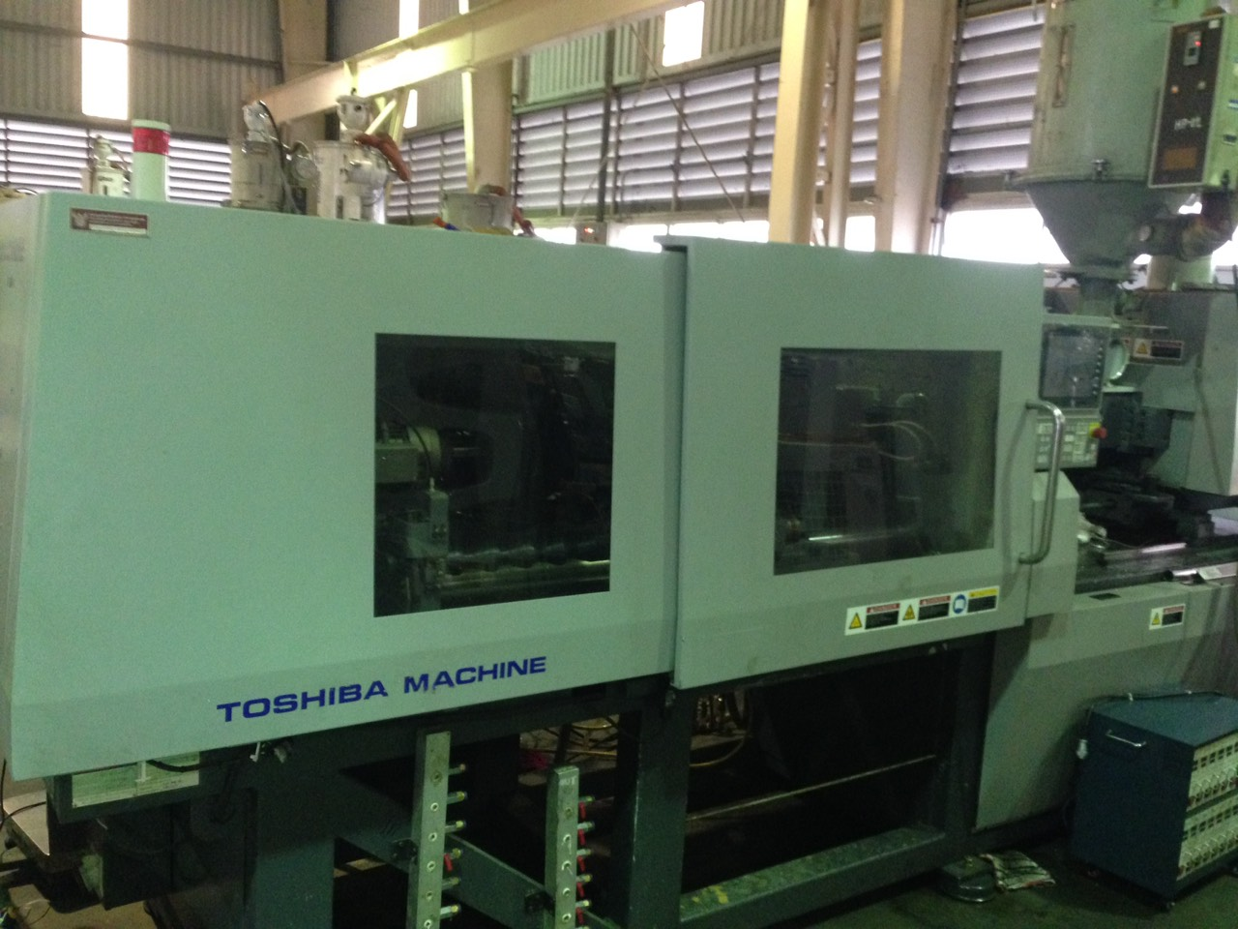
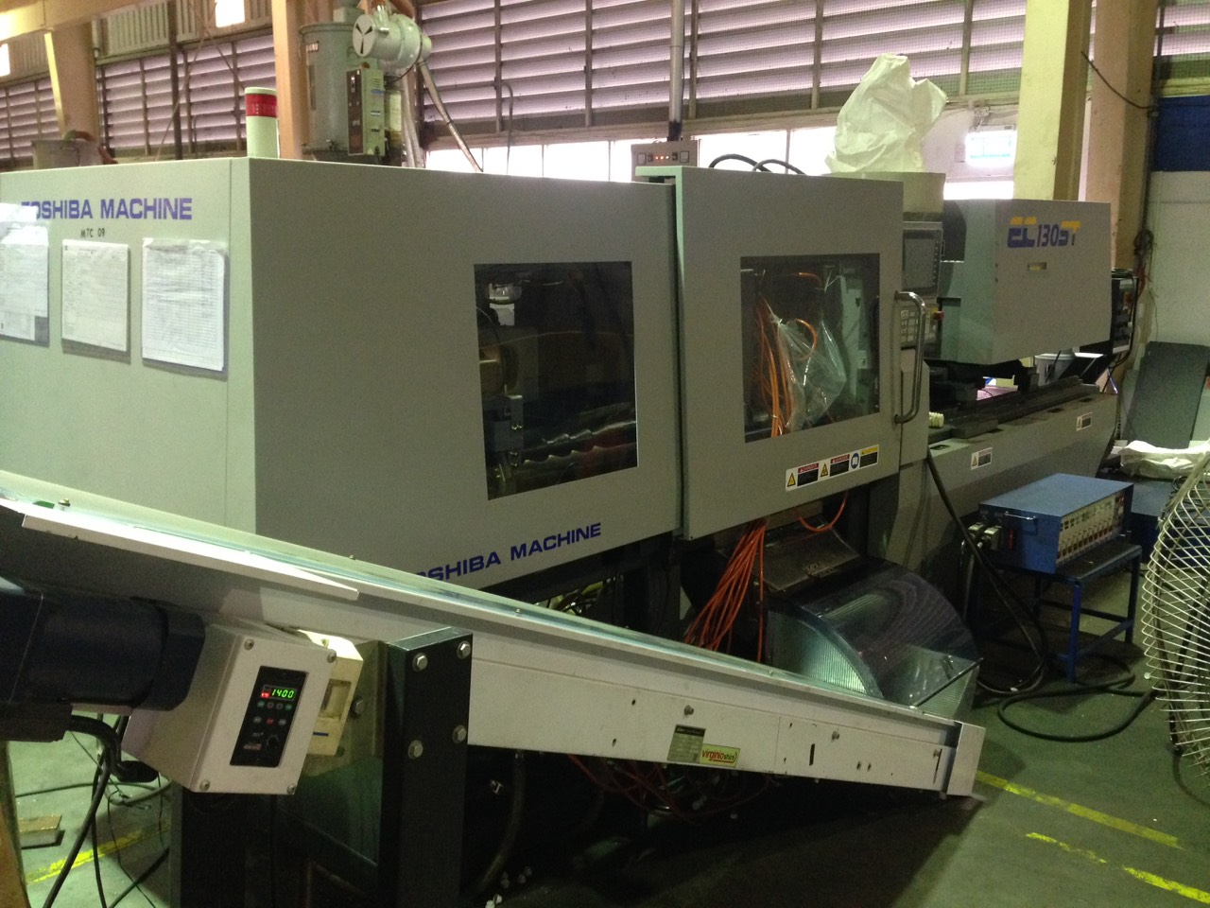
Injection Machine VEM Thailand

Slide 16
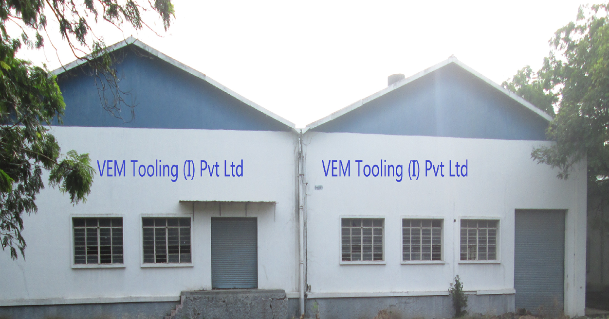
VEM India

Slide 17
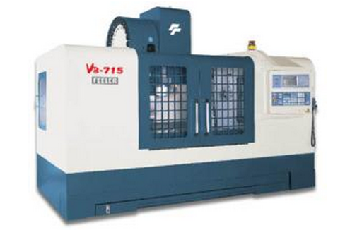
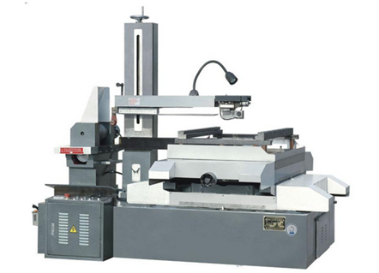
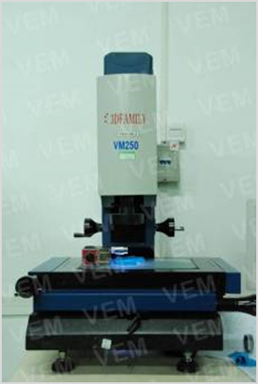
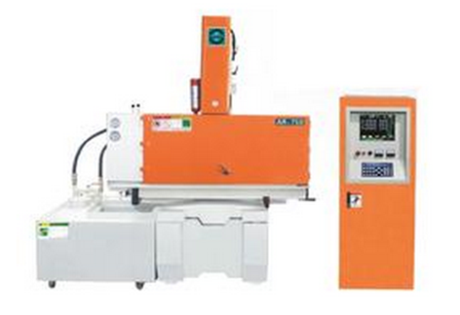
Production Site VEM India

Slide 18
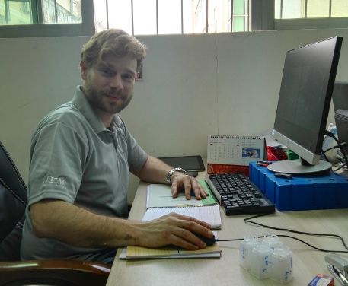
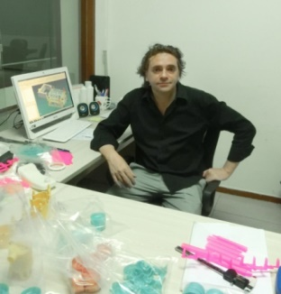
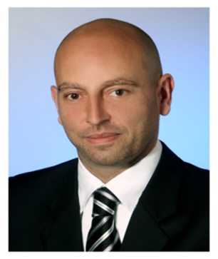
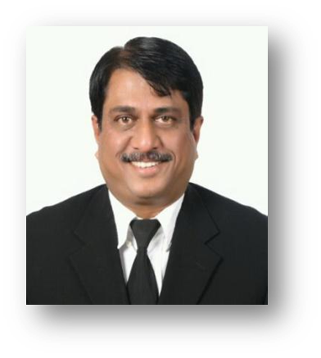
International Management

Slide 19
Personnel Breakdown
China:
Total Staff – 200 Employees - Designers: 16
Project Managers: 10
Thailand:
Total Staff - 70 Employees
Project Managers: 3
India:
Total Staff - 40 Employees
Project Managers: 2
Mold Flow Center

Slide 20
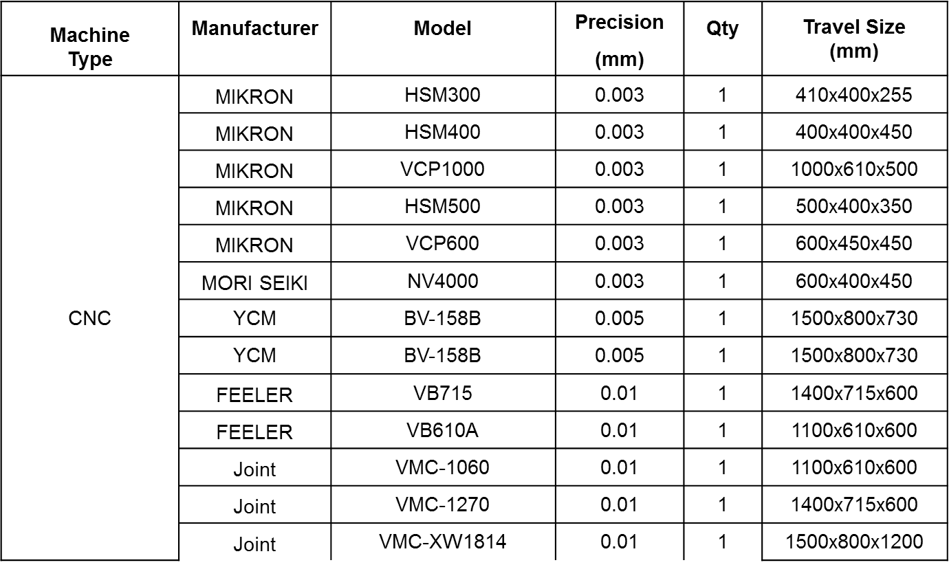
Machine List China

Slide 21
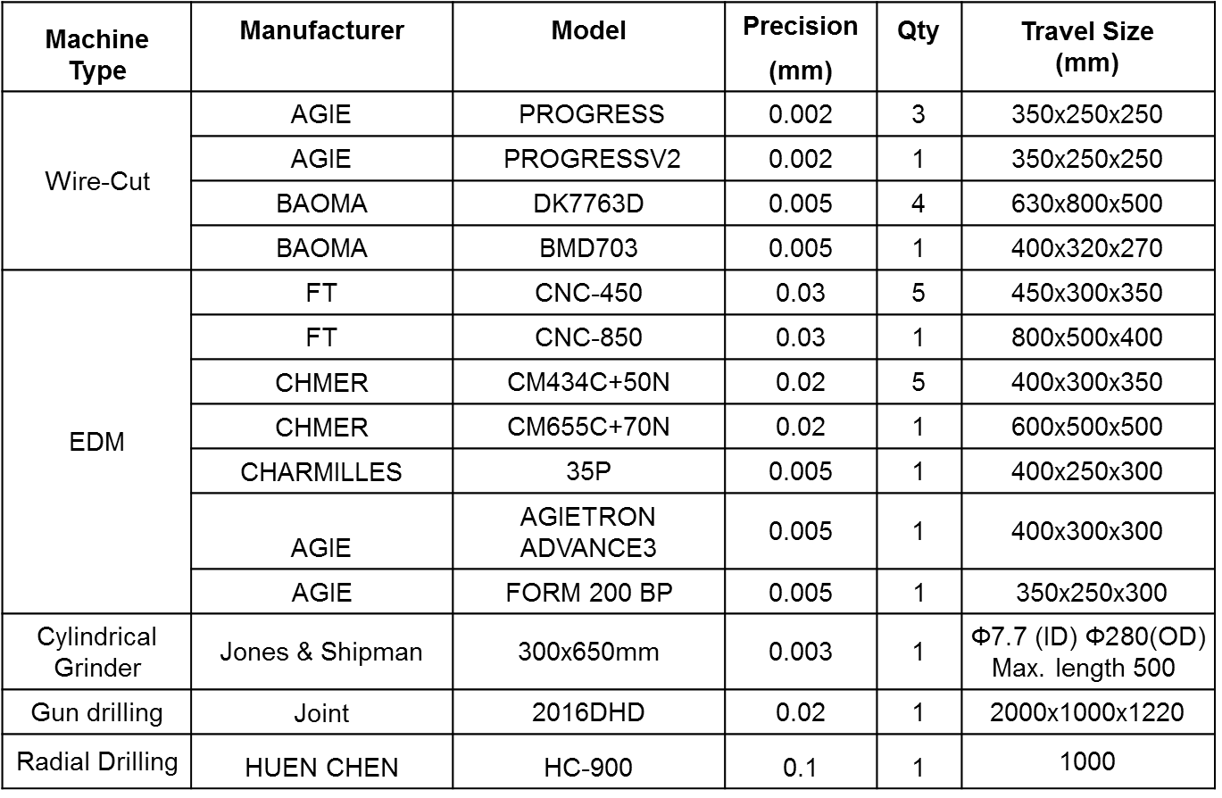
Machine List China

Slide 22
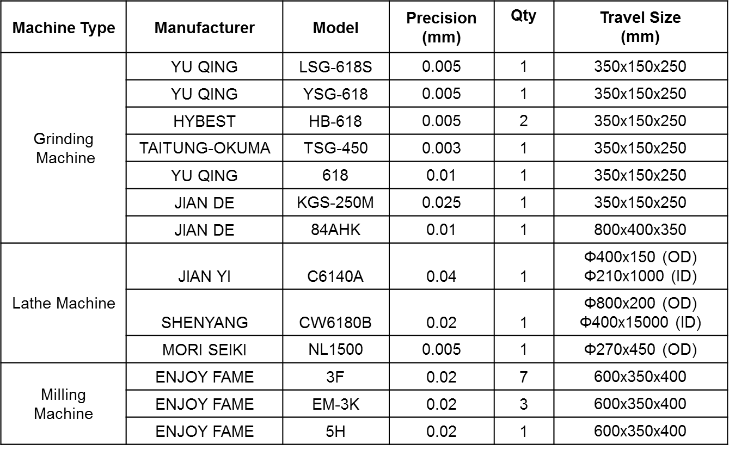
Machine List China

Slide 23
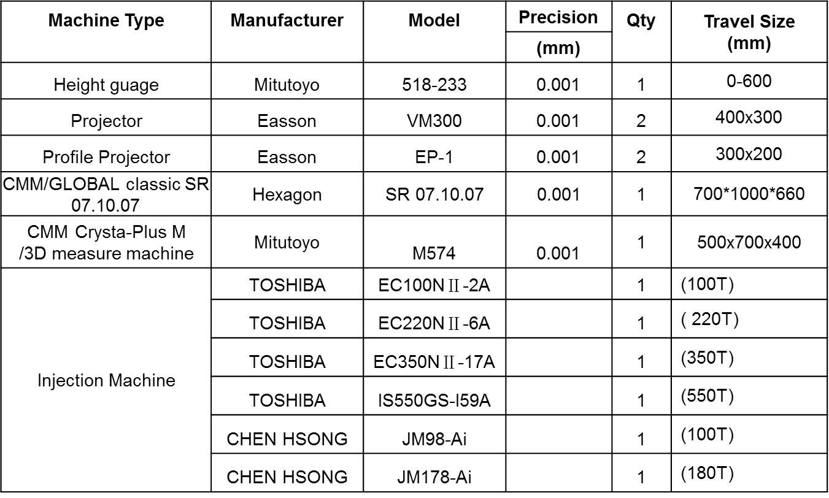
Machine List China

Slide 24
Machine List Thailand

Slide 25
Machine List Thailand

Slide 26
Machine List India

Slide 27
Machine List India

Slide 28
Benefits of working with VEM
High Tech Tool Shop, German owned, with Western Management on site
Complete Project Management with English speaking Engineers and Management
NAFTA and Europe based Contract-Tool-Shops for warranty and modifications

Slide 29
Reference Customers
Customer Industry:
Automotive, Medical, Electronic, Consumer
North America:
Johnson Controls, Siemens, Cepheid, Toro, CareFusion …
Europe:
Audi, BMW, Porsche, Bosch, Huonker, VOIT, LEGO, Hager, BIT, Equashield, BSH …
Asia:
ISUZU, Helvoet, Fisher&Paykel, Electrolux, ARB, Connectwell, B. Braun, BDP, EF Electrical …

Slide 30
VEM Factories & Sales Offices
VEM Shenzhen The 2nd Building, Longhui Industrial Park Fuqiao 3rd Industrial Zone,Fuyong Town Baoan Area, Shenzhen 518103
China
VEM (Thailand)
64/205 Moo 4 Tambon Pluakdaeng
Ampur Pluakdaeng, Rayong 21140
Thailand
VEM Tooling (India) Pvt Ltd
Gat No 125 Hissa No B
A/p Village Mouje Kadamwakwasti Loni Kalbhor
Tal-Haveli,Dist-Pune. India 412201.
VEM Sales Offices in USA
Redondo Beach, California Califon, New Jersey
Email: nicole.vantriel@vem-ltd.com Email: jeff.carroll@vem-ltd.com
VEM Sales Office in Mexico
México, D. F.
Email: gabriel.fernandez@vem-ltd.com
VEM Sales office in Germany
Freiburg, Baden-Wuerttemberg
Email: oliver.weber@vem-ltd.com
VEM Sales Office in India
Pune
Email: g.kabra@vem-ltd.com

Slide 31
Warranty Shops for VEM
Germany
Hans Huonker GmbH Villingen-Schwenningen, Germany
USA Montrose Molders South Plainfield, New Jersey 07080
M&R Mold & Engineering Brea, California 92821
Commercial Tool Comstock Park, Michigan 49321
Mexico
Puebla Queretaro Guadalajara

Slide 32
VEM Shenzhen GPS Coordinates:
22.671382 113.797014

Slide 33
VEM Thailand GPS Coordinates:
12.997944 101.198351

Slide 34
VEM India GPS Coordinates:
18.454289, 74.017689

Slide 35
www.vem-tooling.com
German Precision,
American Service,
Chinese Prices…
That’s VEM.

